Slide 1
CSC 362: System Programming
Lecture 19
Original slides by: Amitabha Dey
Adapted by: Dr. Richard Johnson
Department of Computer Science University of North Carolina at Greensboro

Slide 2

Status Check
Race Conditions
Critical Sections
Atomic Operations
Thread Synchronization
Mutual Exclusion: Mutexes
Thread Safety and Basic Thread-Safe Programming
What we will cover today
Synchronization Mechanism
Dekker’s Algorithm
Busy waiting, flags, limitations
Condition Variables
wait, signal
Semaphores
counters, sem_wait, sem_post

Slide 3
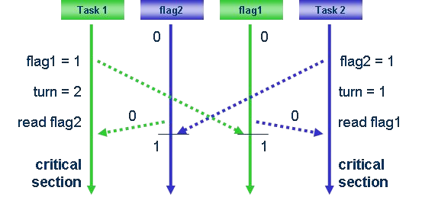
Synchronization Mechanism
Dekker’s Algorithm
Dekker’s algorithm was the first probably-correct solution to the critical section problem. It allows two threads to share a single-use resource without conflict, using only shared memory for communication.
One of the earliest solutions to
mutual exclusion.
Ensures two threads alternate access to a shared resource without relying on modern primitives like mutex locks and semaphores.
Image credit - https://jakob.engbloms.se/
Notes:
Figure:
A sequence diagram illustrating the logic of Dekker’s Algorithm,
showing Task 1 and Task 2 setting flags and
a turn variable to manage access to a critical section.

Slide 4
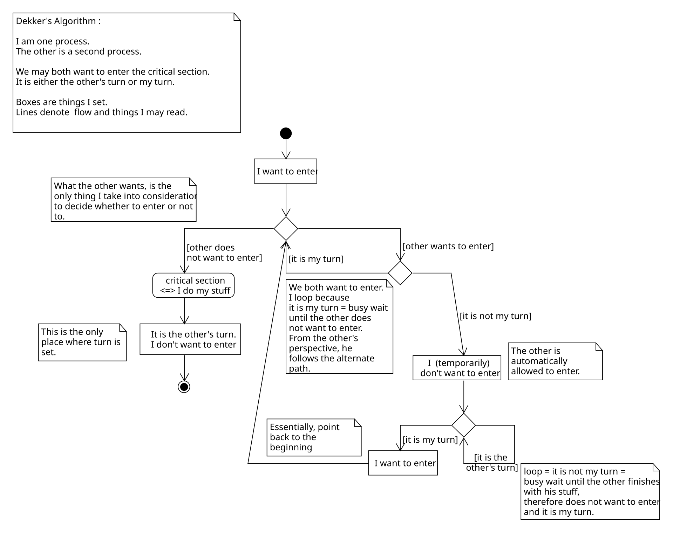
Synchronization Mechanism
Dekker’s Algorithm
If two processes attempt to enter a critical section at the same time, the algorithm will allow only one process in, based on whose turn it is.
If one process is already in the critical section, the other process will busy wait for the first process to exit.
This is done by the use of two flags, wants_to_enter[0] and wants_to_enter[1], which indicate an intention to enter the critical section on the part of processes 0 and 1, respectively, and a variable turn that indicates who has priority between the two processes.
Notes:
Dekker’s Algorithm
Two process solution.
Turn indicator: int turn; indicates who has priority
Flags: bool wants_to enter[2]; indicates intent to enter the critical section

Slide 5

Synchronization Mechanism
Dekker’s Algorithm
If two processes attempt to enter a critical section at the same time, the algorithm will allow only one process in, based on whose turn it is.
If one process is already in the critical section, the other process will busy wait for the first process to exit.
This is done by the use of two flags, wants_to_enter[0] and wants_to_enter[1], which indicate an intention to enter the critical section on the part of processes 0 and 1, respectively, and a variable turn that indicates who has priority between the two processes.
busy waiting is a technique in which a process repeatedly checks to see if a condition is true, such as whether keyboard input or a lock is available.
Image credit - https://dev.to/
Notes:
Figure:
A humorous cartoon of two stick figures;
one is frustrated at a computer while the other sits on the floor with a phone,
"waiting for my turn to print" in a literal interpretation of process waiting.

Slide 6
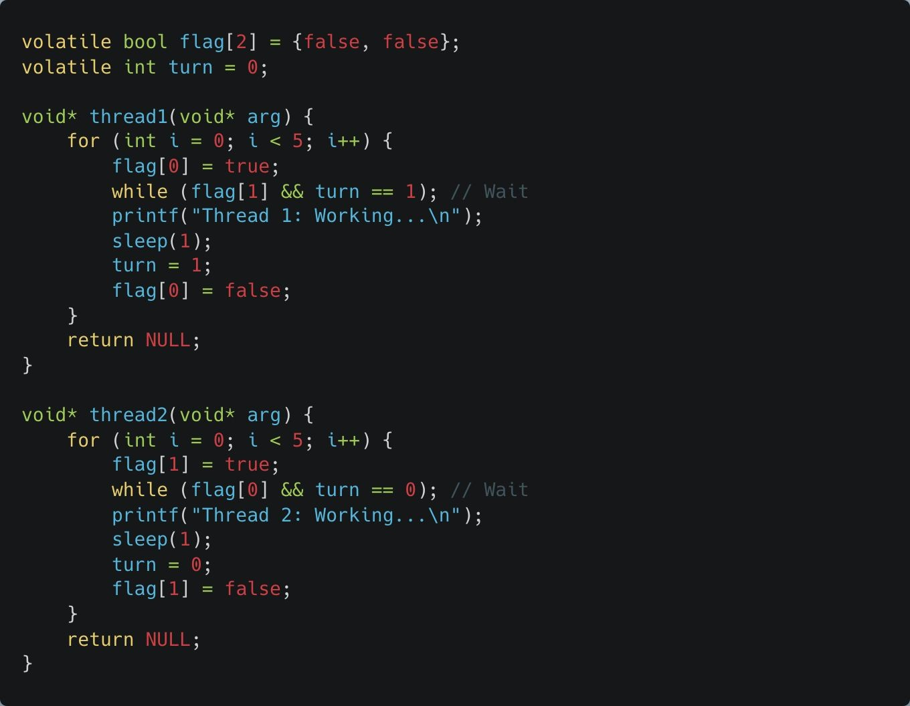
Synchronization Mechanism
Dekker’s Algorithm
flag[2]:
flag[0]: Indicates whether Thread 1 wants to enter the critical section.
flag[1]: Indicates whether Thread 2 wants to enter the critical section.
turn:
Keeps track of whose turn it is to enter the critical section.
Prevents starvation by alternating access.
Volatile:
The volatile keyword ensures that the variables are always read from memory and not optimized away by the compiler, as they are shared between threads.
Notes:
See example:
dekkers_algorithm.c
Volatile keyword:
maintain variables in memory

Slide 7
Synchronization Mechanism
Dekker’s Algorithm
Thread 1 Behavior:
flag[0] = true;
Thread 1 sets its flag[0] to true to signal that it wants to enter the critical section.
Notifies Thread 2 (via flag[0]) that Thread 1 is interested in the critical section.

Slide 8
Synchronization Mechanism
Dekker’s Algorithm
Thread 1 Behavior:
while (flag[1] && turn == 1); Condition:
flag[1]: Checks if Thread 2 also wants to enter the critical section.
turn == 1: Checks if it’s Thread 2's turn to access the critical section.

Slide 9
Synchronization Mechanism
Dekker’s Algorithm
Thread 1 Behavior:
Behavior:
If both flag[1] is true (Thread 2 is interested) and turn == 1 (it's Thread 2's turn), Thread 1 waits in the loop.
The loop continues until:
flag[1] == false: Thread 2 no longer wants to enter.
turn != 1: It becomes Thread 1’s turn to proceed.

Slide 10
Synchronization Mechanism
Dekker’s Algorithm
Thread 1 Behavior:
Purpose: Ensures that Thread 1 does not enter the critical section if:
Thread 2 is also interested, AND
It is Thread 2's turn.

Slide 11
Synchronization Mechanism
Dekker’s Algorithm
Thread 2 Behavior:
Similarly, Thread 2 sets flag[1] to true
to request access.
Waits until:
Thread 1 does not want access (flag[0] == false), or
It is Thread 2's turn (turn != 0).
After completing its work, it sets turn = 0 to give Thread 1 a chance, and clears flag[1].

Slide 12
Synchronization Mechanism
Dekker’s Algorithm - Limitations
Complexity and Inefficiency
Manual Implementation:
Dekker's Algorithm is challenging to implement correctly, as it requires meticulous handling of multiple shared flags and conditions.
Busy Waiting:
The algorithm uses busy waiting (spinning in loops to check conditions), wasting CPU cycles while waiting for access to the critical section.
Modern Solutions:
Mutexes and semaphores provide blocking mechanisms, allowing threads to sleep until access is available, conserving CPU resources.
Limited Scalability
Two-Thread Limit:
Dekker's Algorithm only works for two threads. Extending it to more threads significantly increases complexity, making it impractical for multi-threaded environments.
Modern Solutions:
Mutexes and more advanced algorithms, like Peterson's Algorithm or semaphores, scale better to multiple threads.
Lack of Fairness
Starvation Risk:
Dekker’s Algorithm does not guarantee fairness, as one thread may dominate access to the critical section under certain conditions, causing the other to starve.
Modern Solutions:
Many modern synchronization primitives ensure fairness by using mechanisms like priority queues or round-robin scheduling.
Notes:
Dekker’s Algorithm - Limitations
The three primary drawbacks of Dekker's Algorithm:
complexity, scalability, and fairness.
Complexity and Inefficiency:
Manual Implementation: It is difficult to code correctly because it requires managing multiple shared flags and complex state conditions.
Busy Waiting: The algorithm uses "spinning" (looping) to check conditions. This wastes CPU cycles because the processor is doing work just to wait.
Modern Fix: Mutexes and semaphores use blocking, allowing threads to "sleep" and free up the CPU until they are needed.
Limited Scalability:
Two-Thread Limit: The algorithm is designed strictly for two threads. Extending it to N threads makes the logic exponentially more complex and impractical.
Lack of Fairness:
Starvation Risk: There is no guarantee of "first-come, first-served." One thread might dominate the critical section while the other is left waiting indefinitely (starvation).
Modern Fix: Modern primitives use priority queues or round-robin scheduling to ensure every thread eventually gets a turn.

Slide 13
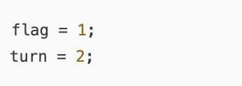
Why Dekker Fails on Modern Systems
Modern compilers and CPUs reorder instructions to optimize performance.
Compilers often reorder instructions during optimization. If the compiler believes two instructions don’t depend on each other, it may swap them to improve performance.
CPUs also perform out-of-order execution: internally reordering memory loads and stores to better utilize CPU pipelines or memory subsystems.
The CPU might write turn = 2 before flag
= 1 if it thinks it can do it faster, even though your code lists them the other way around.
Notes:
Why Dekker Fails on Modern Systems (Reordering)
Hardware and software optimizations break the assumptions made by classic algorithms.
Instruction Reordering:
To improve speed, Compilers may swap the order of two instructions if they appear independent.
Out-of-Order Execution:
CPUs may execute commands in a different order than written to keep their internal "pipelines" full.
The Conflict:
If the code says flag = 1; turn = 2;,
a modern CPU might actually write turn = 2 before flag = 1.
This reordering destroys the logic Dekker’s Algorithm relies on to ensure mutual exclusion.

Slide 14
Dekker’s Algorithm assumes strict memory visibility between threads.
Why Dekker Fails on Modern Systems
Memory operations may not happen in program order.
Even though your code appears sequential, the actual order in which memory writes/reads become visible to other threads can vary.
Especially problematic in multi-core systems: one core’s writes may be cached and delayed before being visible to others.
This means: A thread might see stale values — it sees turn = 2, but not yet flag = 1, because that write is still sitting in a CPU cache.
Dekker's Algorithm relies on:
Each thread’s writes to shared variables being seen immediately by other threads.
Memory operations occurring exactly in the order written.
These assumptions were valid for older single-core or simpler CPU models, but break on modern architectures.
Without enforcing visibility (e.g., using atomics or memory fences), both threads could believe it’s their turn and enter the critical section.
Notes:
Why Dekker Fails (Memory Visibility)
Overview: The difference between "program order" and "visibility“.
Strict Memory Visibility:
Dekker's Algorithm assumes that if Thread A writes a value, Thread B sees it immediately.
The Reality of Multi-Core Systems:
Each core has its own cache. A write might stay in Core 1's cache for a while before being pushed to main memory.
Stale Values: Thread 2 might read an old value from memory because Thread 1’s update is still "buffered" or "cached.“
The Consequence:
Without memory fences or atomic operations,
both threads might think it is their turn simultaneously,
leading to a crash or data corruption.

Slide 15
Why Dekker Fails on Modern Systems
Race Conditions May Still Occur
A write by one thread (e.g., flag1 = 1) may not be seen in time by another thread.
In a multi-core CPU, each core can cache memory separately.
When Thread 1 writes flag1 = 1, that write may stay in its local cache for a short time and not immediately reach main memory.
Meanwhile, Thread 2, running on a different core, may read the old value (flag1 == 0) because it hasn't seen the update yet.
This breaks the synchronization logic because the threads rely on immediate visibility of shared flags to coordinate access.
Conditions like while (flag2 && turn == 2) may fail to detect the true state.
These while-loops are guard conditions — they’re supposed to block a thread until it’s safe to enter the critical section.
If instruction reordering or delayed visibility causes one thread to miss the update made by the other, the condition fails to block, even though it should.
This leads to:
Threads skipping the wait.
Both thinking it's their turn, due to stale or reordered values.
Notes:
Why Dekker Fails (Race Conditions)
Scenario where the lack of immediate visibility causes a failure.
Delayed Visibility:
If Thread 1 sets flag1 = 1 but it stays in the local cache,
Thread 2 will still see flag1 == 0.
Failing to Block:
Because Thread 2 sees the old value,
its while loop (the guard condition) fails to trigger.
The Result:
Both threads "skip the wait" and enter the critical section at the same time.
This is a race condition that breaks the synchronization logic entirely.

Slide 16
Synchronization Mechanism
Condition Variables
A condition variable is a synchronization primitive that allows threads to wait for a specific condition to become true before proceeding.
They work in conjunction with a mutex to avoid busy-waiting, where a thread repeatedly checks a condition in a loop, wasting CPU cycles.
Threads can:
Wait on a condition variable until another
thread signals that the condition is met.
Signal the condition variable to wake up one or more waiting threads.
Recommended reading:
http://www.robert-puskas.info/2019/03/over view-cpp-concurrency-pt2.html
Notes:
Synchronization Mechanism - Condition Variables
Introduces a more sophisticated tool for thread coordination.
Definition:
A Condition Variable is a primitive that allows a thread to wait for a specific state to change before it continues.
Efficiency:
They are used alongside Mutexes to eliminate busy-waiting.
Instead of looping, the thread stays dormant until it receives a signal.
Key Operations:
Wait: The thread puts itself to sleep and releases the mutex until another thread signals it.
Signal: A thread that changes the shared state "wakes up" one (or more) waiting threads to let them know they can try to proceed.

Slide 17
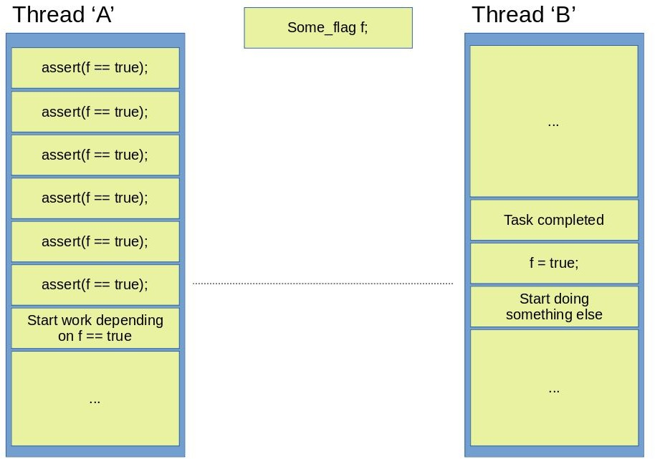
Synchronization Mechanism
Condition Variables
Thread ‘A’ is continuously polling f to check if it becomes true.
This is the most basic way to wait for a particular condition to become true, which can be implemented with a simple loop. Thread ‘A’ polls f continuously until it becomes true, which is resource hungry operation.
Because of that, this approach is also called a busy-wait.
Image credit - http://www.robert-puskas.info/
Notes:
The Problem - Busy-Waiting (Polling)
Illustrates the most basic (and inefficient) way to wait for a condition.
Definition of Polling:
A thread repeatedly checks a shared variable (like f == true) in a tight loop.
Mechanism:
Thread ‘A’ constantly executes an assert or check.
It doesn't move forward until Thread ‘B’ completes its task and sets f = true.
The Drawback (CPU Waste):
This is "resource hungry."
The CPU is running at 100% just to check a flag,
preventing other useful work from being done on that core.

Slide 18
Synchronization Mechanism
Condition Variables
Thread ‘A’ is continuously polling f to check if it becomes true.
Polling means repeatedly checking a condition in a loop without performing any other useful task until the condition becomes true.
It means Thread A is repeatedly looking at the value of f in a loop (or similar construct) to see if it has changed to true.
CPU Waste: Polling keeps the CPU busy in an unnecessary loop, consuming processing power without doing meaningful work.
Inefficiency: Instead of sleeping or yielding to let other threads or processes use the CPU, Thread A constantly runs the check.
Image credit - http://www.robert-puskas.info/
Notes:
Mechanism:
Thread ‘A’ constantly executes an assert or check.
It doesn't move forward until Thread ‘B’ completes its task and sets f = true.
The Drawback (CPU Waste):
This is "resource hungry."
The CPU is running at 100% just to check a flag,
preventing other useful work from being done on that core.

Slide 19
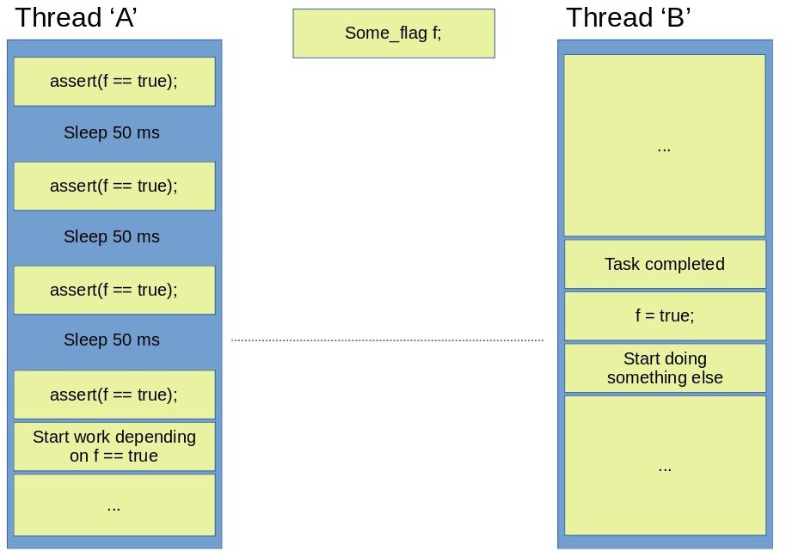
Synchronization Mechanism
Condition Variables
Thread ‘A’ polls f continuously, but some sleeping periods are inserted between asserts to free computing resources.
The problem with such an approach is that it is really hard to guess how much time is needed between asserts.
If the time is too short, than the actual gain is of going to sleep periodically is quite minimal because of the extra resource consumed by the context switches themselves.
If the time is too long on the other hand, than there is a high chance that the waiting thread will waste huge amounts of time if the condition becomes true quite early in the wait period.
Image credit - http://www.robert-puskas.info/
Notes:
The "Naive" Fix - Polling with Sleep
Attempts to fix busy-waiting by adding sleep() commands.
The Idea:
Insert a small delay (e.g., 50ms) between checks to free up the CPU.
The "Goldilocks" Problem:
Time too short: High overhead from constant context switching (the OS moving the thread in and out of the CPU).
Time too long: Poor responsiveness. If the condition becomes true at 1ms into a 50ms sleep, the thread wastes 49ms just sleeping, causing a lag in the application.

Slide 20
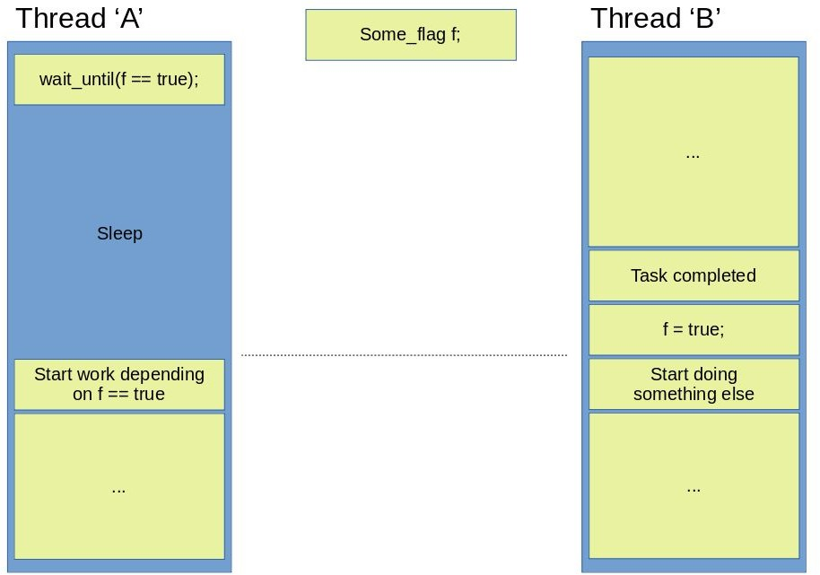
Synchronization Mechanism
Condition Variables
Thread ‘A’ simply sleeps until f becomes true. Computing resources are free to be utilized by other tasks in the meantime.
Image credit - http://www.robert-puskas.info/
Notes:
The Efficient Goal - True Sleeping
Introduces the ideal behavior that synchronization primitives aim to achieve.
Wait until True:
Thread ‘A’ should perform a wait_until operation.
Resource Management:
Instead of checking or periodically waking up,
the thread is put into a "blocked" state by the OS.
Benefit:
Zero CPU cycles are consumed by Thread ‘A’ while it waits.
The CPU is 100% free for other tasks.

Slide 21
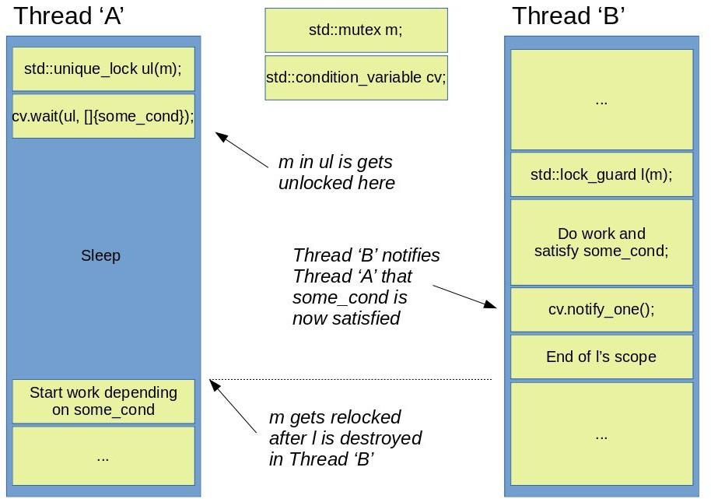
Synchronization Mechanism
Condition Variables
Utilizing a std::condition_variable to wait for some condition to be met.
Image credit - http://www.robert-puskas.info/
Notes:
The Implementation - std::condition_variable
The C++ standard library's way of implementing the "True Sleeping" goal.
The Components:
std::mutex m: Protects the shared condition.
std::unique_lock ul(m): A wrapper that manages the mutex.
cv.wait(ul, ...): This is the "magic" step. It atomically releases the mutex and puts the thread to sleep.
The Wake-up Call:
Thread ‘B’ finishes its work and calls cv.notify_one().
Thread ‘A’ is woken up, re-acquires the mutex, and continues its work.

Slide 22
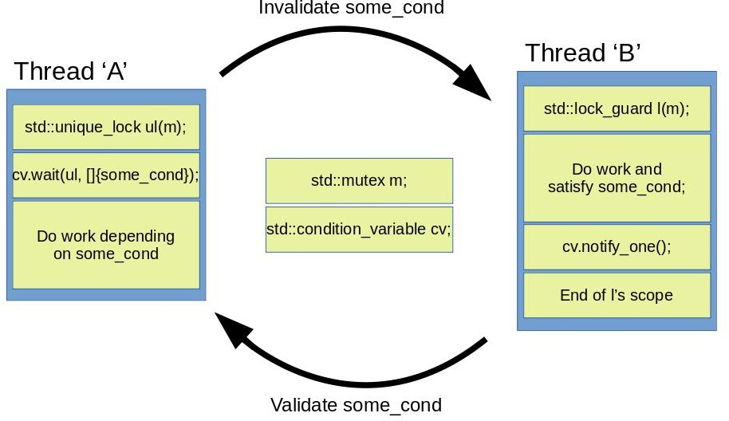
Synchronization Mechanism
Condition Variables
A usual workflow that utilizes condition variables.
Image credit - http://www.robert-puskas.info/
Notes:
The Standard Workflow (Validation/Invalidation)
Summarizes the lifecycle of a condition variable synchronization.
Validation:
Thread ‘B’ performs work that makes the condition true ("Validates") and then notifies the waiting thread.
Invalidation:
Once Thread ‘A’ wakes up and finishes its dependent work,
it may reset the condition ("Invalidates") so the cycle can begin again.
The Loop of Cooperation:
This creates a clean "Hand-off" between threads without the heat, noise, and waste of busy-waiting.

Slide 23
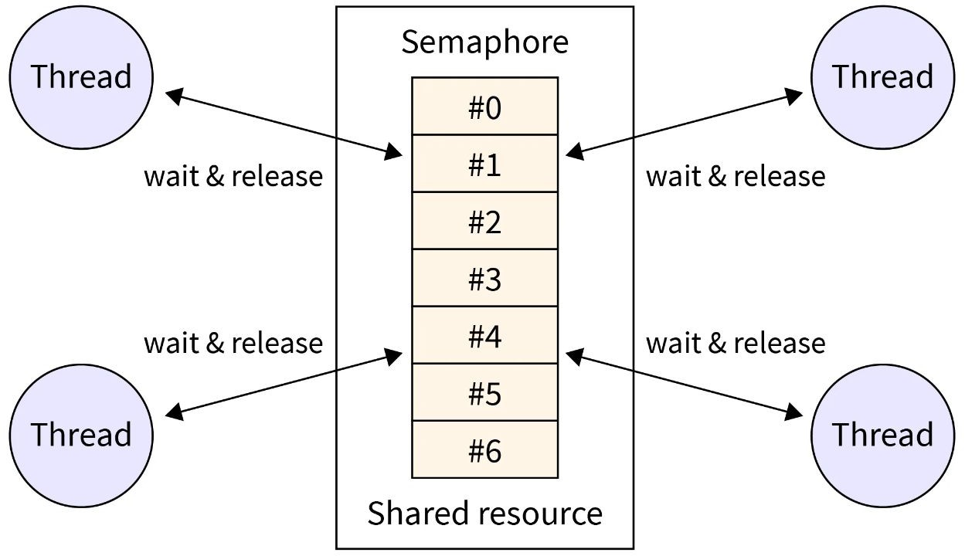
Synchronization Mechanism
Semaphores
A semaphore is a counter that controls access to shared resources.
It can limit the number of threads accessing a resource (e.g., only 3 threads can enter a critical section).
Functions: sem_wait (decrement) and sem_post (increment).
A parking lot with 5 spaces. Each car thread checks the semaphore (spots available). If a spot is free, the thread parks (decrement). When the car leaves, it increments the semaphore.
Image credit - https://www.scaler.com/

Slide 24
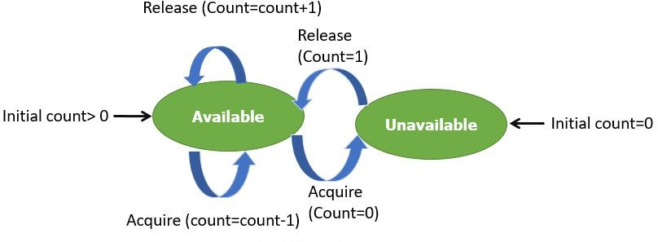
Synchronization Mechanism
Semaphores
A semaphore is usually implemented as an integer with two operations:
Increment (post or signal): The increment operation is used to increase the value of a semaphore.
Decrement (wait or acquire): The decrement operation is used to decrement or reduce the value of a semaphore.
A resource is indicated as 'available' when the value of a semaphore in Linux is positive. On the other hand, a resource is indicated as 'busy' or 'blocked' when the value of a semaphore is negative.
Image credit - https://www.guru99.com/

Slide 25
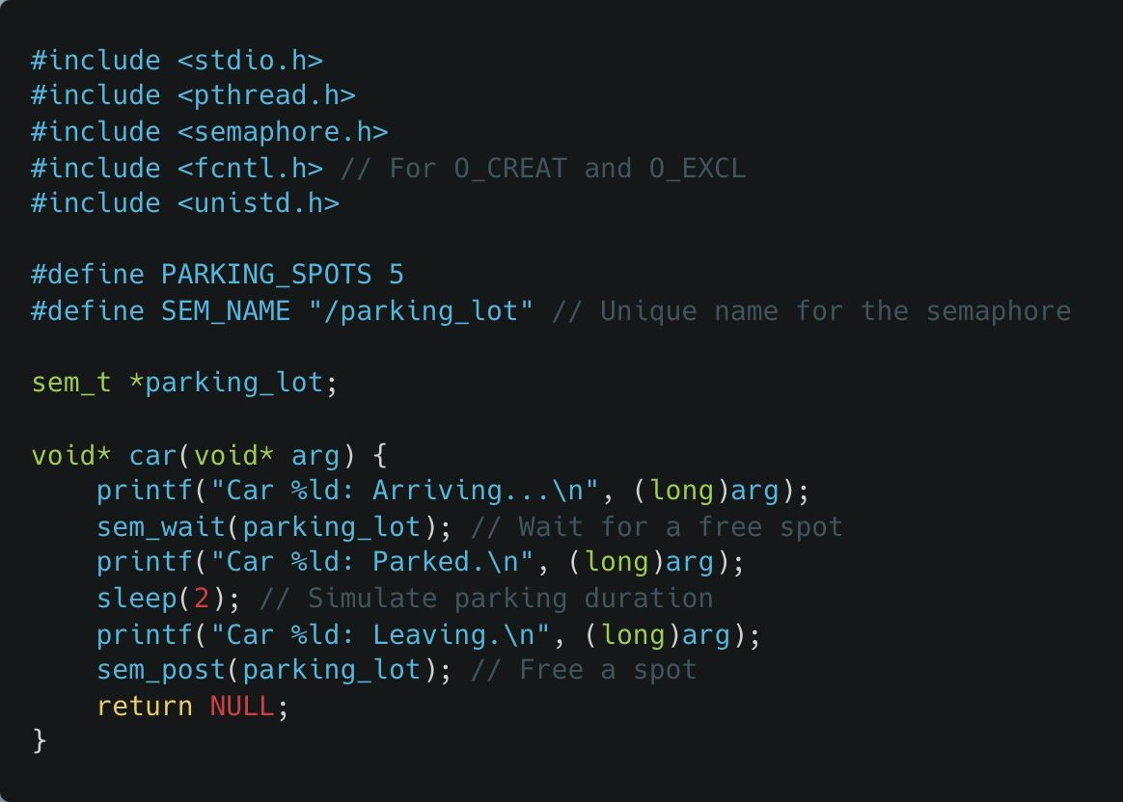
Synchronization Mechanism
Semaphores
Semaphore Declaration and Initialization
SEM_NAME: This defines a unique name for the semaphore,
/parking_lot. Named semaphores are system-wide and identified by their name.
sem_t *parking_lot: A pointer to the semaphore object, which will be initialized in the main function.
Notes:
See example:
semaphore.c

Slide 26
Synchronization Mechanism
Semaphores
Thread Function: car
Thread Argument (arg):
The arg represents the car's unique ID, passed when creating the thread in the main function. It’s cast to long for display.

Slide 27
Synchronization Mechanism
Semaphores
Thread Function: car
Arrival of the Car (sem_wait):
sem_wait(parking_lot) decreases the semaphore value, representing a car taking a parking spot. If all spots are taken (semaphore value is 0), this call blocks until a spot is available.

Slide 28
Synchronization Mechanism
Semaphores
Thread Function: car
Parking (printf and sleep):
Simulates the car parking by printing a message and sleeping for 2 seconds to represent the duration of parking.

Slide 29
Synchronization Mechanism
Semaphores
Thread Function: car
Leaving the Parking Spot (sem_post):
sem_post(parking_lot) increases the semaphore value, indicating the car has left and a spot is now available.

Slide 30
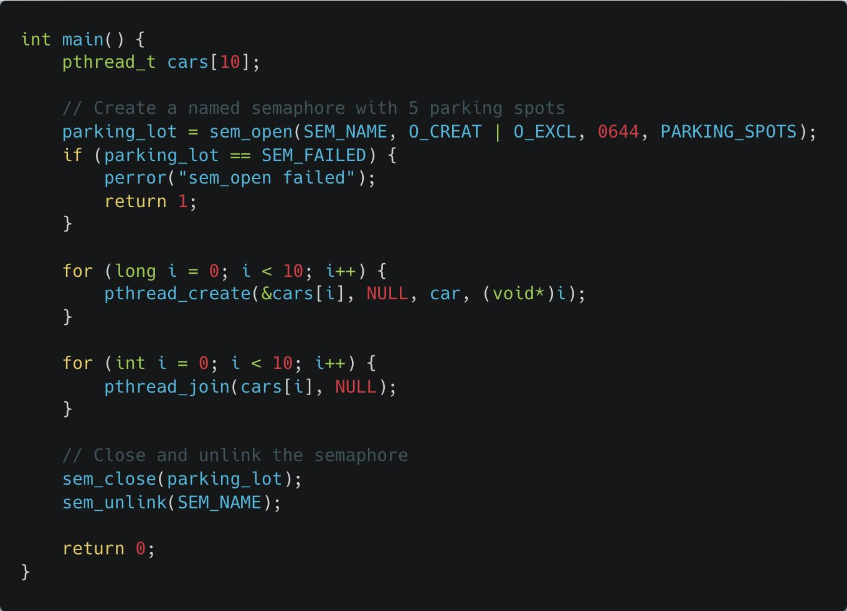
Synchronization Mechanism
Semaphores
Semaphore Creation
sem_open:
Creates a named semaphore
identified by SEM_NAME.
The flags O_CREAT | O_EXCL ensure the semaphore is created fresh and not reused from previous runs.
0644: Sets permissions (read/write for owner, read-only for others).
PARKING_SPOTS: Initializes the semaphore value to 5, representing the 5 available parking spots.

Slide 31
Synchronization Mechanism
Semaphores
Semaphore Creation
sem_open
:
es a named semaphore
ied by SEM_NAME.
ags O_CREAT | O_EXCL
e the semaphore is created nd not reused from previous
Sets permissions (read/write ner, read-only for others).
ING_SPOTS: Initializes the
Creat identif
The fl ensur
The sem_open function is used to create or open a named semaphore. The typical call looks like this:
name: The name of the semaphore (e.g., /semaphore_name).
oflag: Flags that control how the semaphore is created or opened.
mode: File permissions for the semaphore (optional; used when creating).
value: Initial value of the semaphore (optional; used when creating).
fresh a
runs.
0644:
for ow
PARK
semaphore value to 5, representing the 5 available parking spots.

Slide 32
Synchronization Mechanism
Semaphores
S
s
emaphore Creation
em_open:
● Creates a named semaphore
identified by SEM_NAME.
● The flags O_CREAT | O_EXCL ensure the semaphore is created fresh and not reused from previous runs.
● 0644: Sets permissions (read/write for owner, read-only for others).
● PARKING_SPOTS: Initializes the semaphore value to 5, representing the 5 available parking spots.
O_CREAT (Create):
Purpose: Creates the semaphore if it doesn’t already exist.
Use Case: Needed when you want to ensure the semaphore is created if it's not already available.
O_EXCL (Exclusive):
Purpose: Ensures that sem_open will fail if the semaphore already exists.
Use Case: Prevents accidental reuse of an existing semaphore. This is useful for avoiding race conditions during initialization.
Combined (O_CREAT | O_EXCL):
Together, these flags:
Create the semaphore only if it does not exist.
Fail with an error (EEXIST) if the semaphore already exists.

Slide 33
Synchronization Mechanism
Semaphores
S
s
0644 (Mode)
Purpose:
The mode specifies the permissions for the semaphore, similar to file permissions in Unix.
0644 Breakdown:
The mode is in octal and defines read/write permissions:
6 (owner): Read (4) + Write (2).
4 (group): Read (4).
4 (others): Read (4).
emaphore Creation
em_open:
Creates a named semaphore
identified by SEM_NAME.
The flags O_CREAT | O_EXCL ensure the semaphore is created fresh and not reused from previous runs.
0644: Sets permissions (read/write for owner, read-only for others).
PARKING_SPOTS: Initializes the semaphore value to 5, representing the 5 available parking spots.
●
●
●
Explanation for Students:
●
Owner (creator of the semaphore) has read and write permissions.
Group and others have read-only permissions.
This is a typical setting for shared semaphores.

Slide 34
Synchronization Mechanism
Semaphores
Semaphore Creation
Error Handling:
If the semaphore cannot be created (e.g., a naming conflict), sem_open returns SEM_FAILED, and the program exits with an error message.

Slide 35
Synchronization Mechanism
Semaphores
Thread Creation & Joining
Creates 10 threads (cars), each simulating a car attempting to park.
pthread_create:
Takes the car thread (car) as the entry function.
Passes the car's unique ID (i, cast as
void*) to distinguish between threads.
Ensures the main function waits for all 10 threads (cars) to complete before proceeding.
Prevents the program from exiting prematurely while threads are still running.

Slide 36
Synchronization Mechanism
Semaphores
Semaphore Cleanup
sem_close:
Closes the semaphore, releasing the process-specific reference to it.
sem_unlink:
Removes the named semaphore (/parking_lot) from the system, ensuring no lingering system-wide semaphore remains after the program exits.

